Slide 1



Slide 2
About today…
React Hooks
useReducer

Slide 3
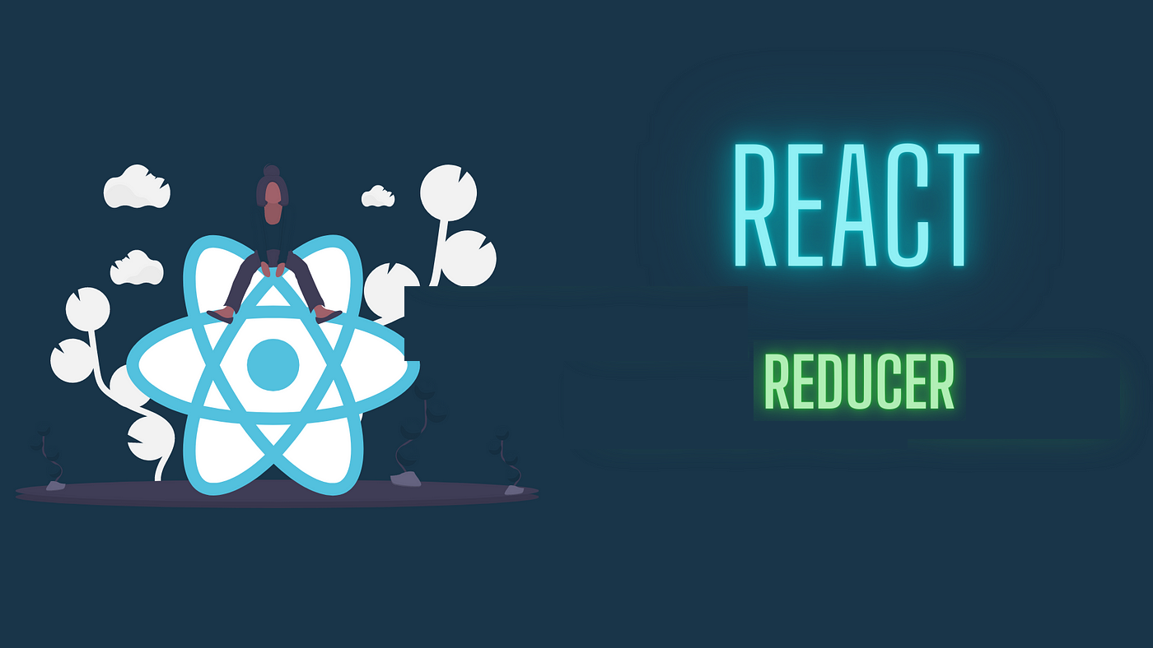

Slide 4
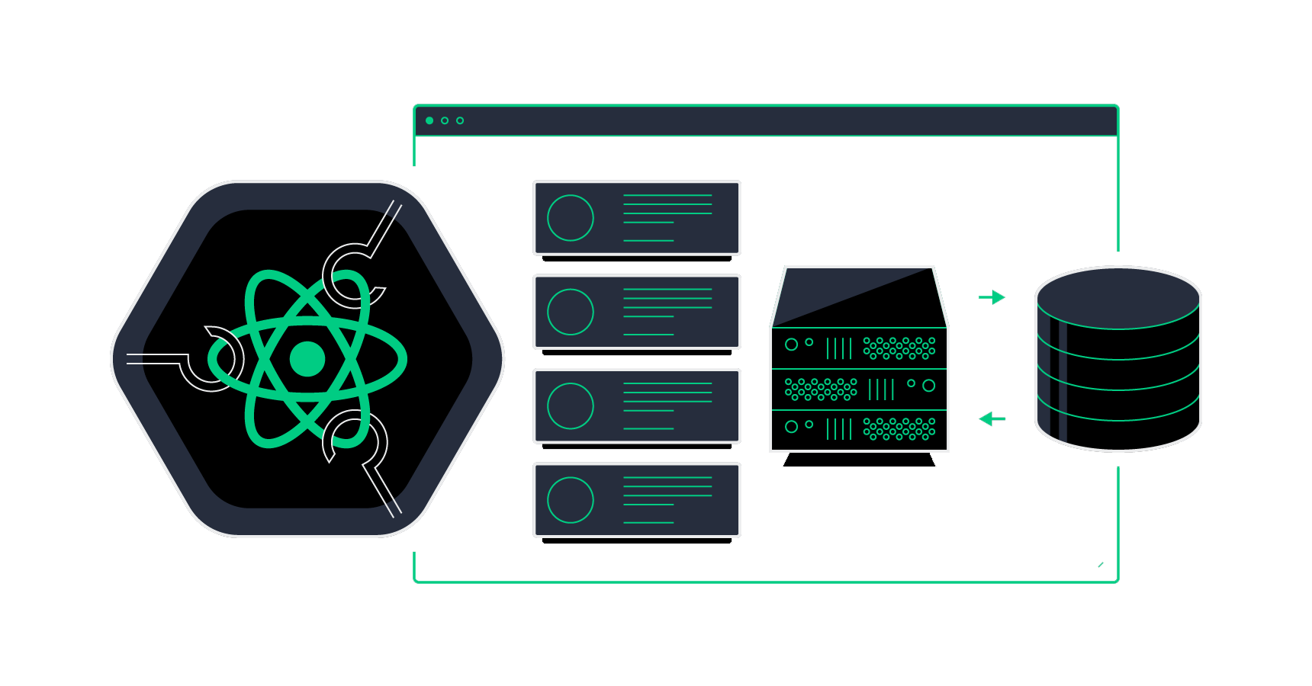
Issues with useState
Simple State Management
‘useState’ is great for basic state needs but can become cumbersome with complex state logic
Multiple State Variables
Managing many individual state variables can lead to fragmented and hard-to-maintain code.
State Dependencies
Complex state updates, especially those dependent on previous state, can be error-prone
Component Re-rendering
Frequent state changes can cause unnecessary re-renders, affecting performance

Slide 5
Need for Centralized State Management
Complex State Logic
As applications grow, managing state across multiple components becomes challenging
State Synchronization
Ensures consistency and synchronization of state across different parts of the application
Maintainability
Centralized state management helps in keeping code organized and easier to maintain
Debugging
Easier to debug state-related issues with a single source of truth

Slide 6
Usage of useReducer
Introduction
‘useReducer’ is an alternative to ‘useState’ for managing complex state logic
Reducer Function
Manages state transitions based on actions
Dispatching Actions
Use ‘dispatch’ to trigger state updates
Initial State
Define the initial state and provide it to ‘useReducer’

Slide 7
Working of useReducer

Slide 8
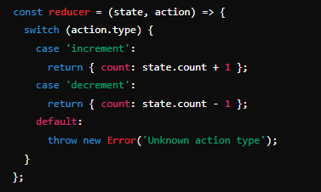
Working with useReducer - Details
Reducer Function
Defines how state changes based on actions
Syntax

Slide 9
Initial State
Defines how state changes based on actions
Syntax
Dispatch Actions
Trigger state updates with action dispatch

Slide 10
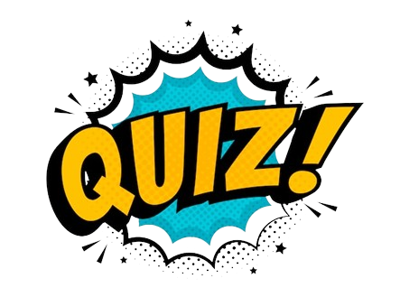
What is a primary limitation of using useState for managing complex
state logic?
Managing multiple state variables can be cumbersome
Which hook is generally recommended for managing complex state logic with multiple related
values?
useReducer
In useReducer, what does the dispatch function do?
It triggers an action to update the state
What is the purpose of the reducer function in useReducer?
To handle state transitions based on actions

Slide 11
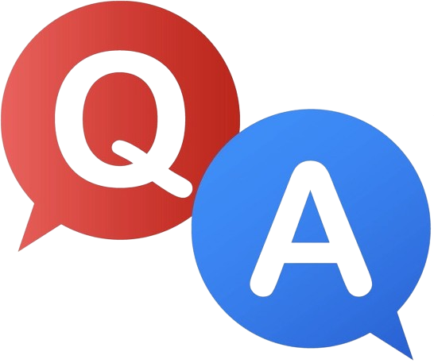

Slide 12

Task
Create an event registration form with validation for email and event selection, and display a confirmation message upon submission

